Slide 1
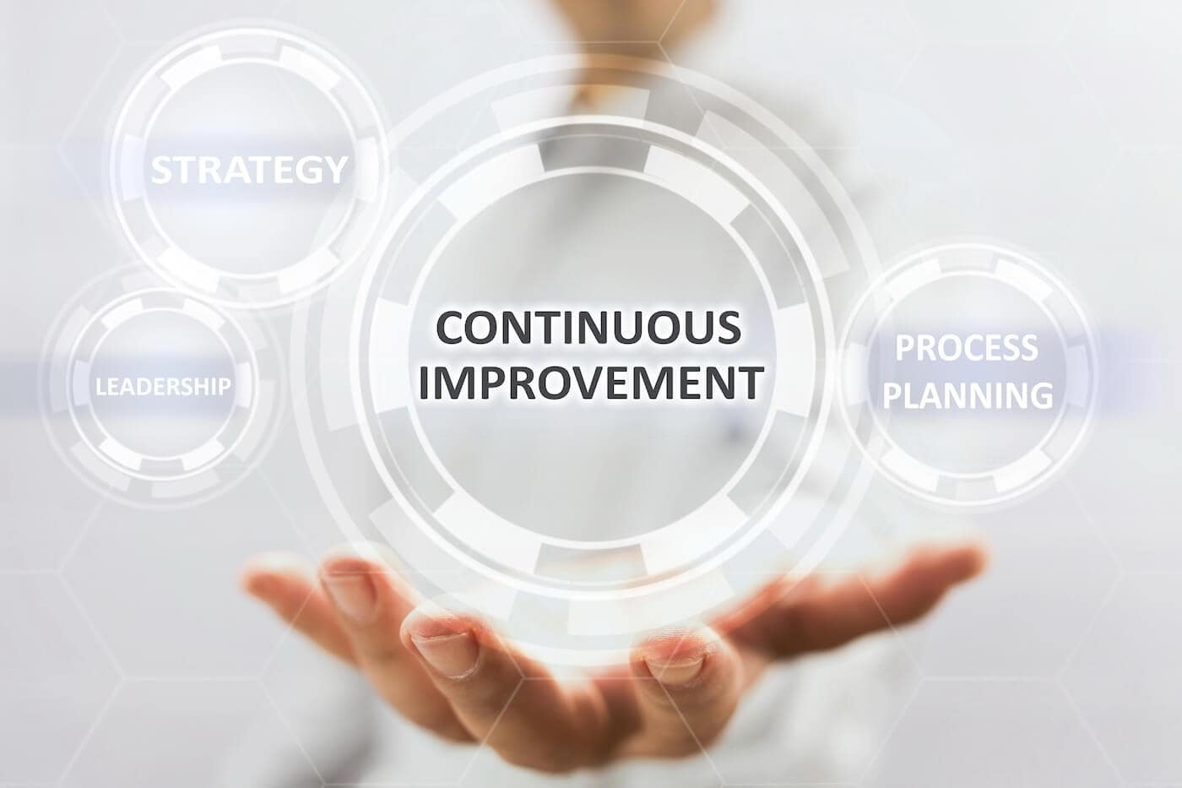



PROCESS IMPROVEMENT Design for Seamless Integration with Existing Manufacturing Systems

Slide 2


DIGITALIZED DATA MANAGEMENT SYSTEM
Problem Statement
In view of rapidly evolving industrial landscape, the need for efficient, digital and sustainable production processes is more critical than ever.
Traditional paper-based workflows on the production floor have been a source of inefficiency, error, and environmental concern.
AIM & VISION
In view of the above Problem Statement, we aimed at developing an innovative software solution thereby revolutionizing production floor operations by transitioning to a paperless environment.
The primary objective of this software development initiative is to eliminate the reliance on paper-based documentation, such as work orders, production details, product specifications, and quality control records, within the manufacturing process.
By digitizing and centralizing these critical documents, we can significantly enhance productivity, reduce operational costs, and minimize environmental impact.
“Productivity is never an accident. It is always the result of a commitment to excellence, intelligent planning and focused effort.” – Paul J Meyer

Slide 3
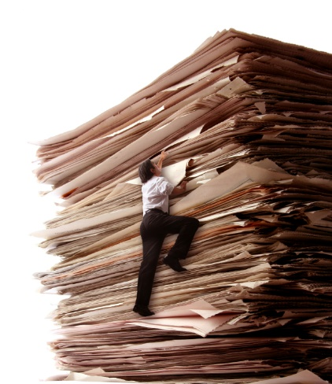





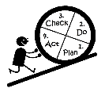
DIGITALIZED DATA MANAGEMENT SYSTEM
Advantages
Internal Customer Satisfaction – This development led to migration of manual paper-base data collection system to a digitalized & more effective form of data management enhancing traceability, legibility & real-time monitoring.
Increased Profitability to the organization – Real-time data analysis provides a scope for continual improvement thereby adding profit numbers.
Development of in-house technical expertise, teamwork and leadership
Process Improvement & Institutionalization – This improvement can be spread across the whole company to institutionalize in various other plants of Mitsubishi.
“Always deliver more than expected.” – Larry Page

Slide 4
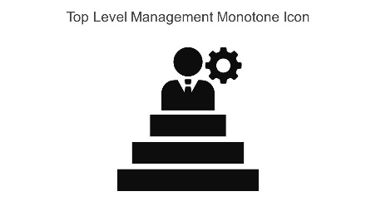


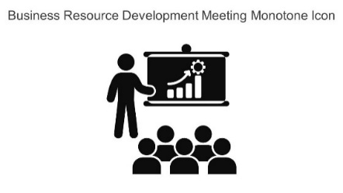


ACCESS LEVELS
Top Management
Plant Manager
Safety & Production
Engineering
Material
Production Supervisor
Maintenance
Production Operator
Material Handler
Sales
Quality
Quality Inspector
Technician
Launched & Live
Under Development
Future Expansion
“Do it Right the First Time and Every Time” – Henry Ford

Slide 5
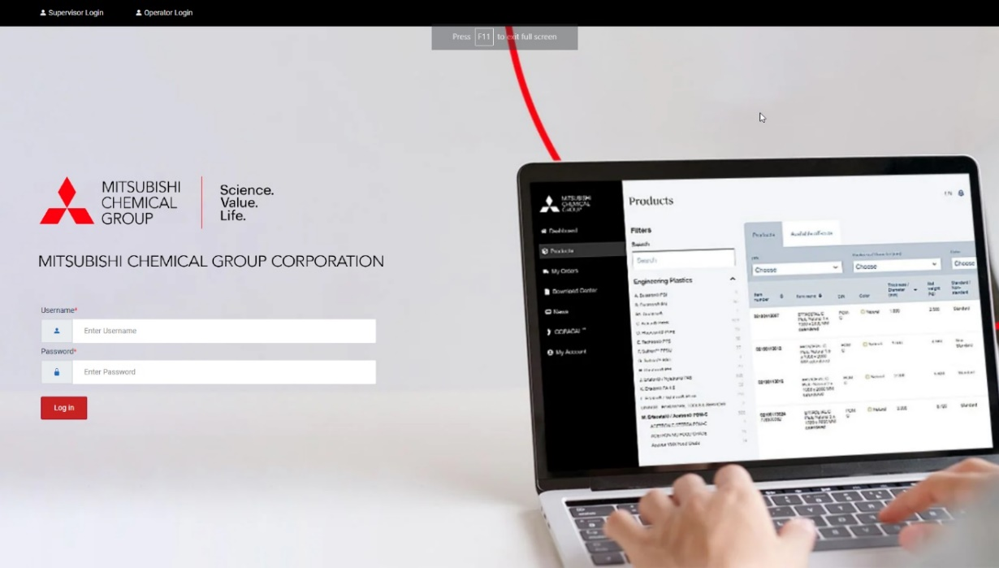
DIGITALIZED DATA MANAGEMENT SYSTEM
Login Page
Each user is given the credentials (username and password) for logging into the system. Based on the level of access, the users can view the respective pages.
“Quality is everyone’s responsibility, and we never have to stop getting better.” – W. E. Deming & Jimena Calfa

Slide 6
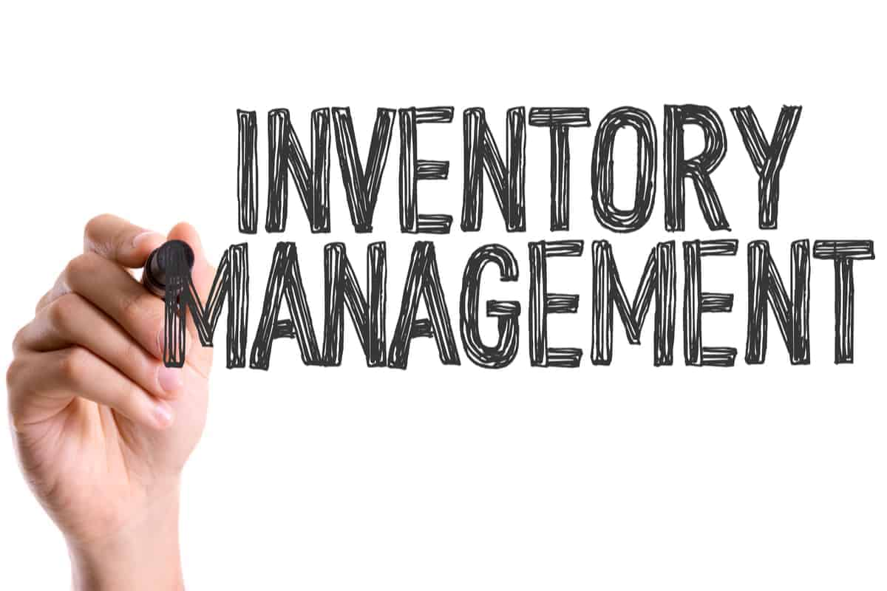

DIGITALIZED DATA MANAGEMENT SYSTEM
Material Department Access
“Quality is everyone’s responsibility, and we never have to stop getting better.” – W. E. Deming & Jimena Calfa

Slide 7
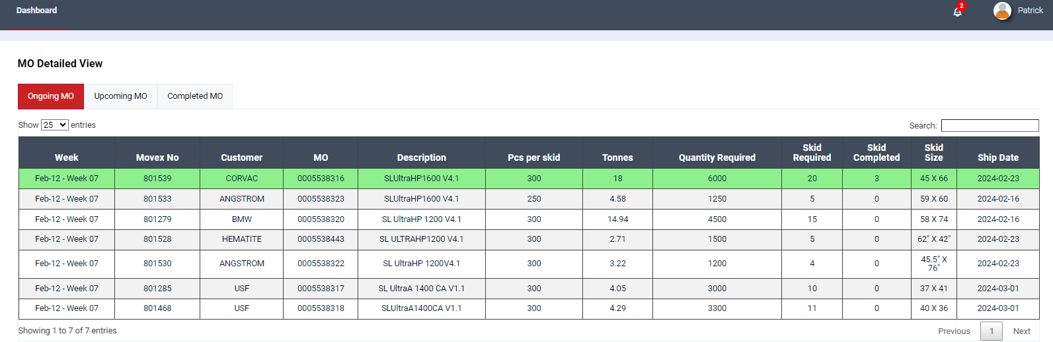
DIGITALIZED DATA MANAGEMENT SYSTEM
After logging into the system
Dashboard Page
It displays all the ongoing MOs for the current week. It also highlights the product being produced currently in green.
“Quality is everyone’s responsibility, and we never have to stop getting better.” – W. E. Deming & Jimena Calfa

Slide 8
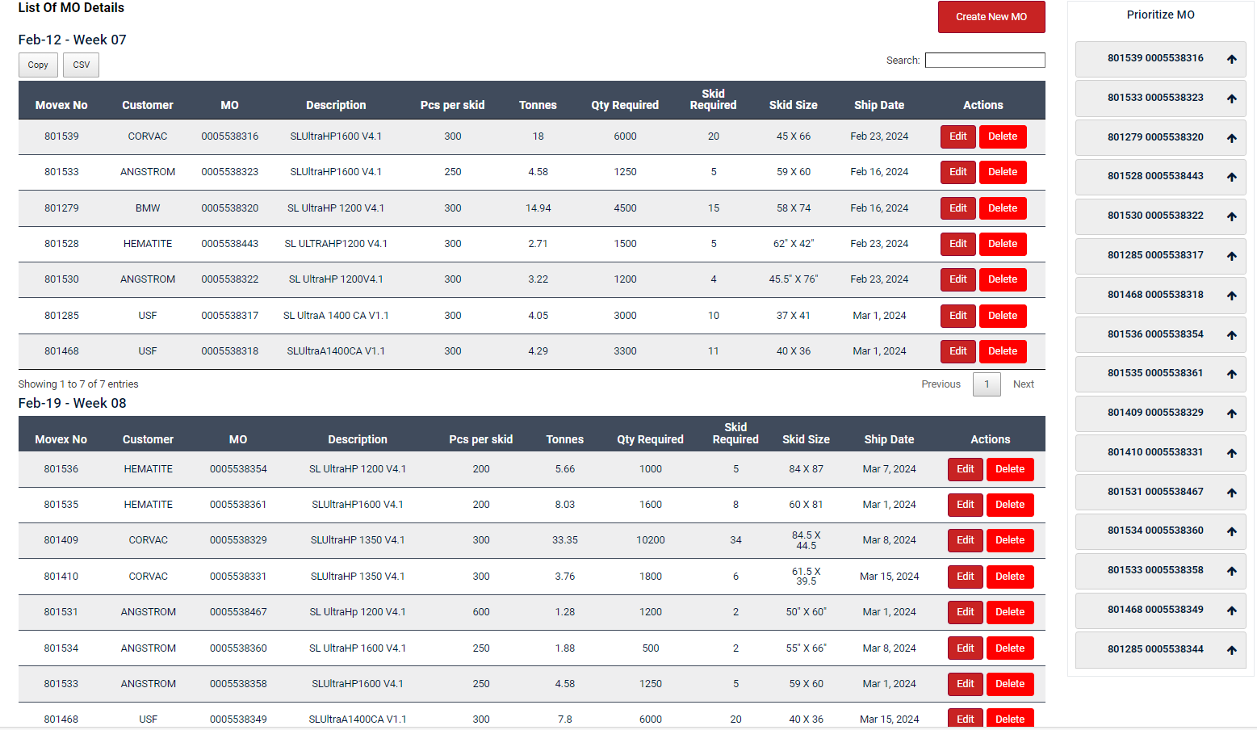
DIGITALIZED DATA MANAGEMENT SYSTEM
MO List Page
Material Manager can add new MO by selecting “Create New MO”, Edit and Delete a particular MO in the planning for the current and next week’s MO list .
Also, the MOs in the list can be prioritized.
“Continuous Improvement is better than delayed perfection.” – Mark Twain

Slide 9
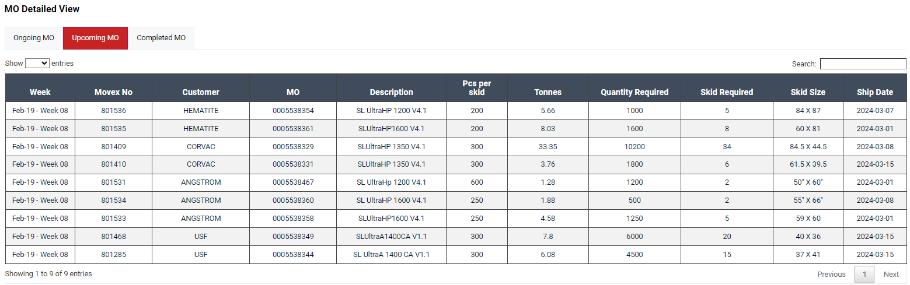
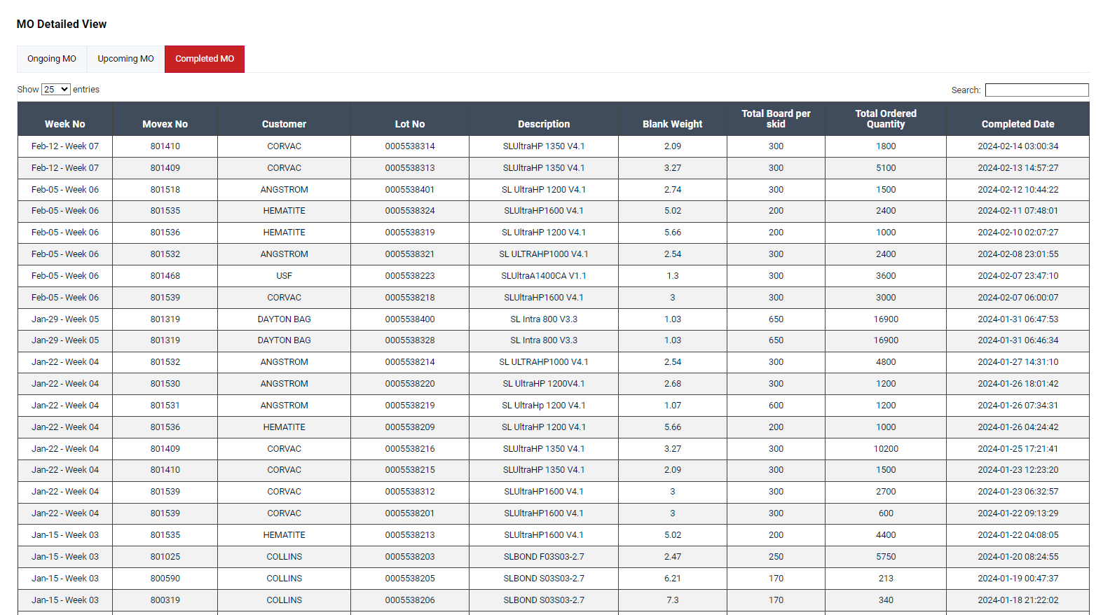
DIGITALIZED DATA MANAGEMENT SYSTEM
Upcoming MO Planning
Next week’s lookahead plan for MOs can also be updated & depicted in this page along with the planned shipping date.
Completed MOs List
It displays all the completed MOs along with the completed date & time.
“The key is not to prioritize what’s on the schedule, but to schedule your priorities.” – Stephen Covey

Slide 10
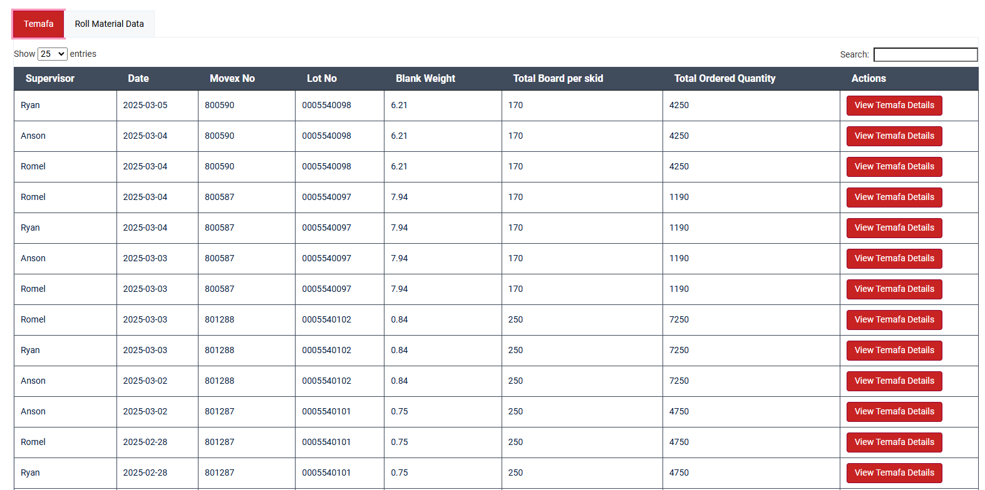
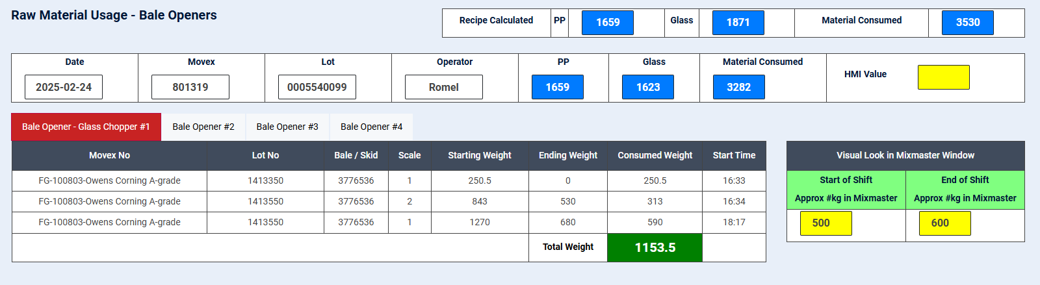
DIGITALIZED DATA MANAGEMENT SYSTEM
Raw Material Consumption
The Material Manager has the facility to view the raw material details entered by the operator, both shift-wise and in a detailed view
They can filter the information based on date, supervisor, Movex number, and lot number
“Continuous Improvement is better than delayed perfection.” – Mark Twain

Slide 11
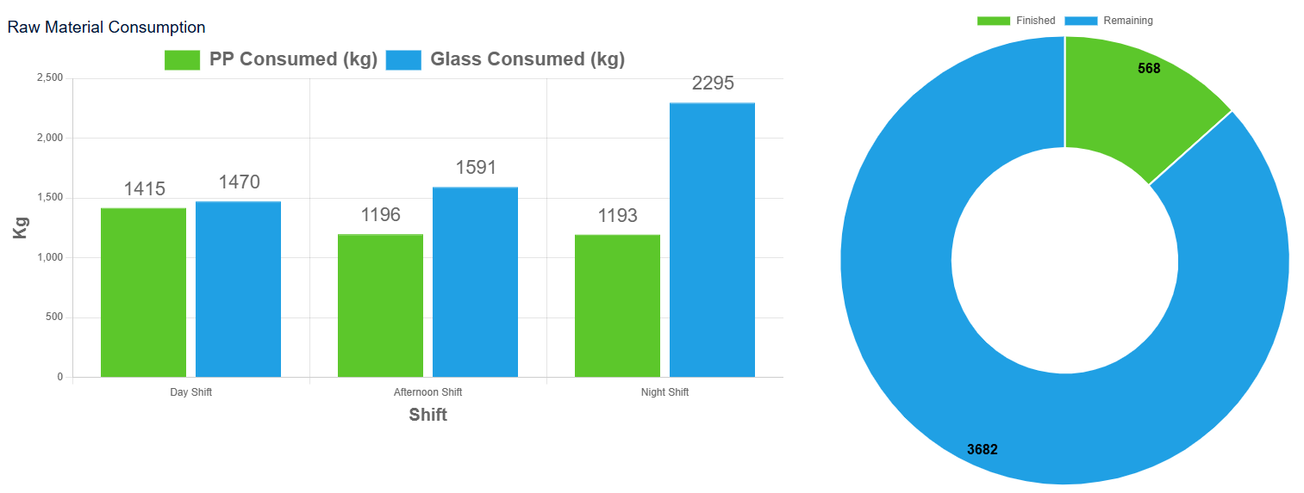
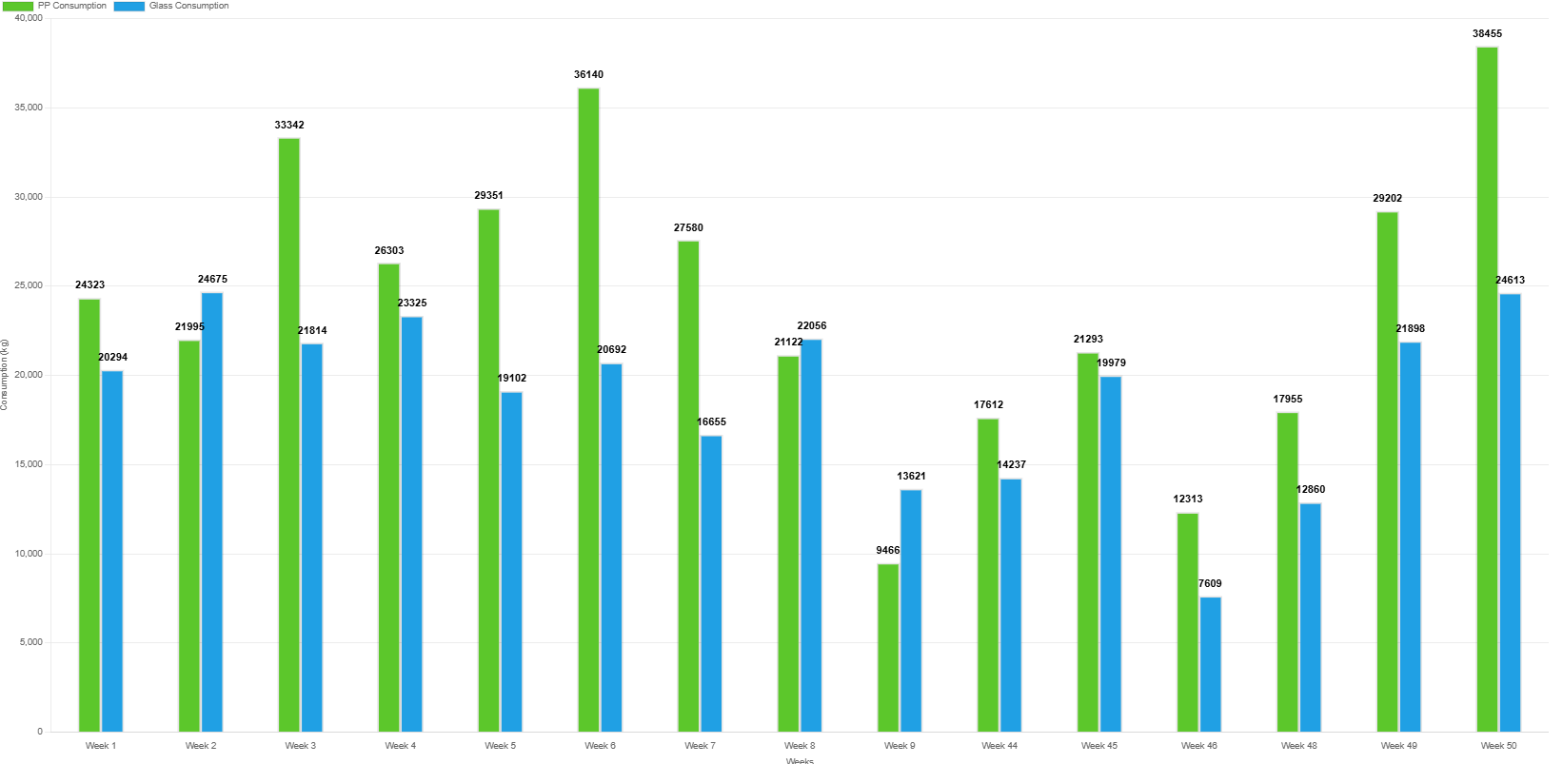
DIGITALIZED DATA MANAGEMENT SYSTEM
It provides a visualization of glass and PP raw material consumption, categorized by shift
The donut chart represents and shows how many boards are needed to complete the process and how many have been done
It provides a bar chart visualization of glass and PP raw material usage over the last 3 months, broken down by week.
“The key is not to prioritize what’s on the schedule, but to schedule your priorities.” – Stephen Covey

Slide 12
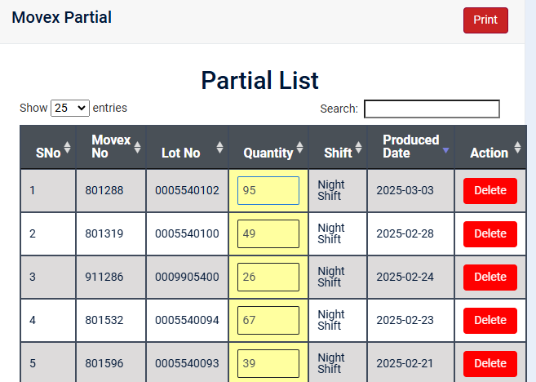
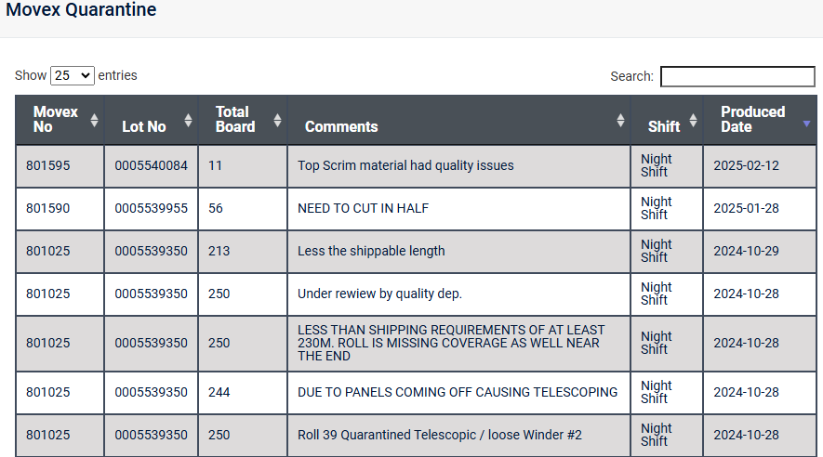
DIGITALIZED DATA MANAGEMENT SYSTEM
Partial
They can view the partial list in their login, and the yellow textbox is editable, allowing them to correct any errors.
Quarantine
It displays all the boards marked as quarantine by the supervisor
“The key is not to prioritize what’s on the schedule, but to schedule your priorities.” – Stephen Covey

Slide 13
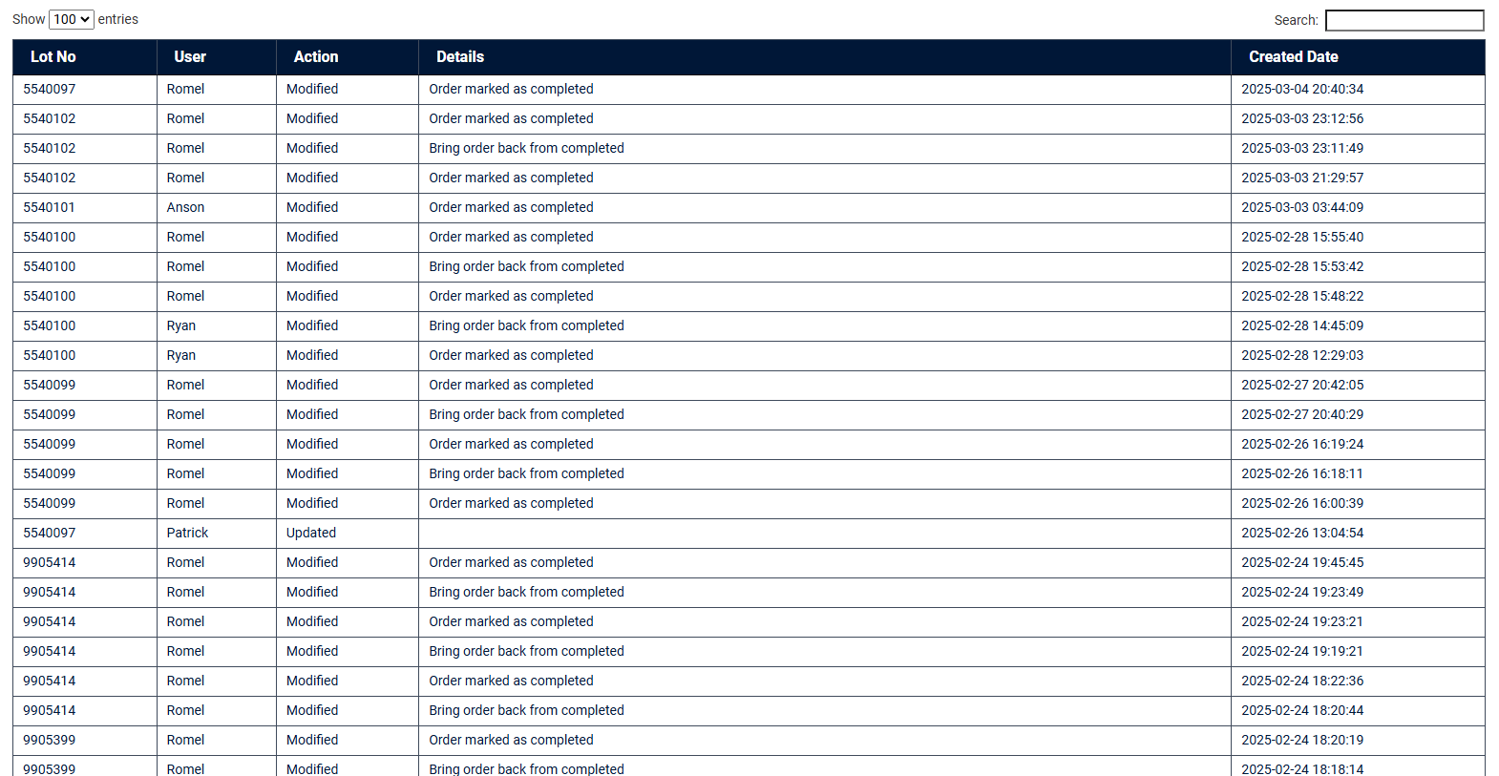
DIGITALIZED DATA MANAGEMENT SYSTEM
Audit Schedule
Any changes made in the MO schedules, priorities, addition/deletion is recorded in the form of an Audit log and the same can be accessed by the Material Manager for reviewing the changes made.
“Continuous Improvement is better than delayed perfection.” – Mark Twain

Slide 14


DIGITALIZED DATA MANAGEMENT SYSTEM
Operator Access
“Quality is everyone’s responsibility, and we never have to stop getting better.” – W. E. Deming & Jimena Calfa

Slide 15
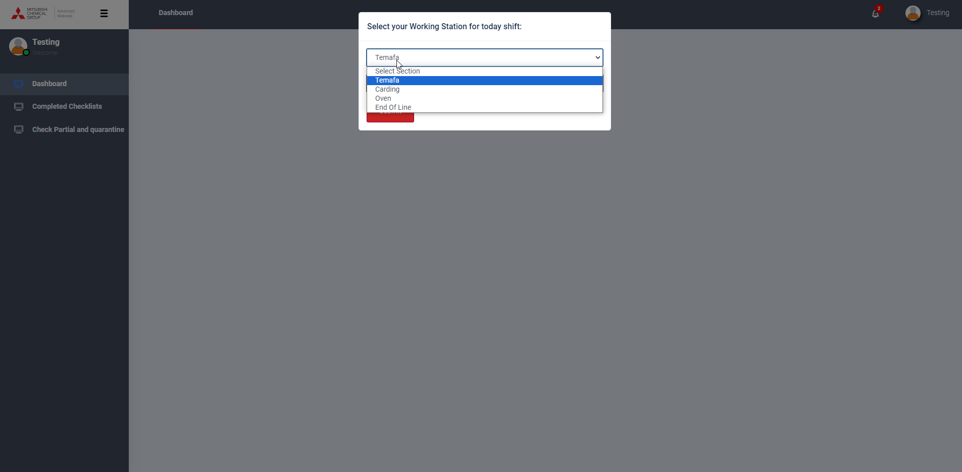
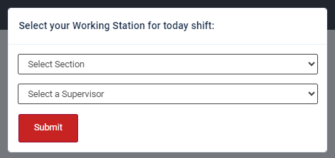
DIGITALIZED DATA MANAGEMENT SYSTEM
Production Operators, after logging into the system using their credentials, now select the section.
Section selection by Operator
Operators select their respective section (Temafa, Carding, Oven or End of Line) & supervisor of their current shift.
“Quality is everyone’s responsibility, and we never have to stop getting better.” – W. E. Deming & Jimena Calfa

Slide 16
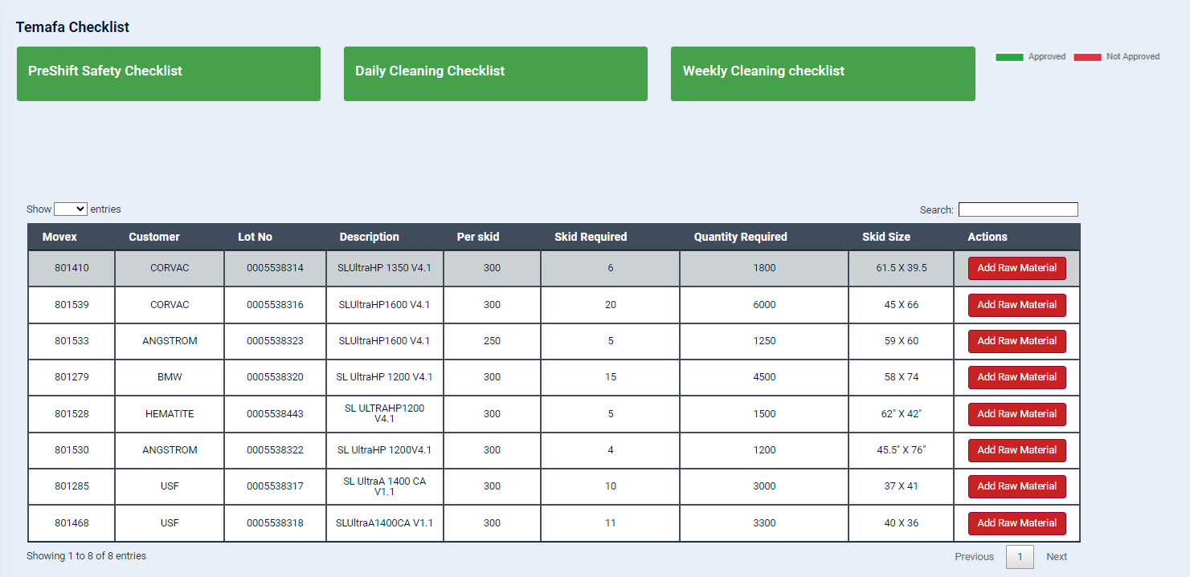
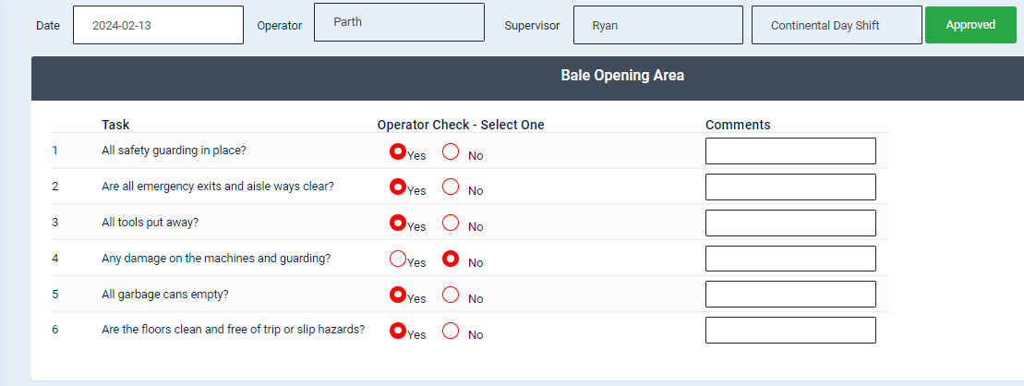
DIGITALIZED DATA MANAGEMENT SYSTEM
Machine-specific Checklists Page
Checklists for the selected machine for example – Temafa shall be shown in this page. Operator has to fill in each of the checklists timely.
Reminders will be generated every hour for completion of the checklist.
The below is a sample of checklist to be filled by the operator.
Temafa – Add Raw Material
Operator selects the particular item number being produced and adds the raw material to each bale as shown in the next screen.
“Improve Quality, you automatically improve Productivity.” – W. Edwards Deming

Slide 17
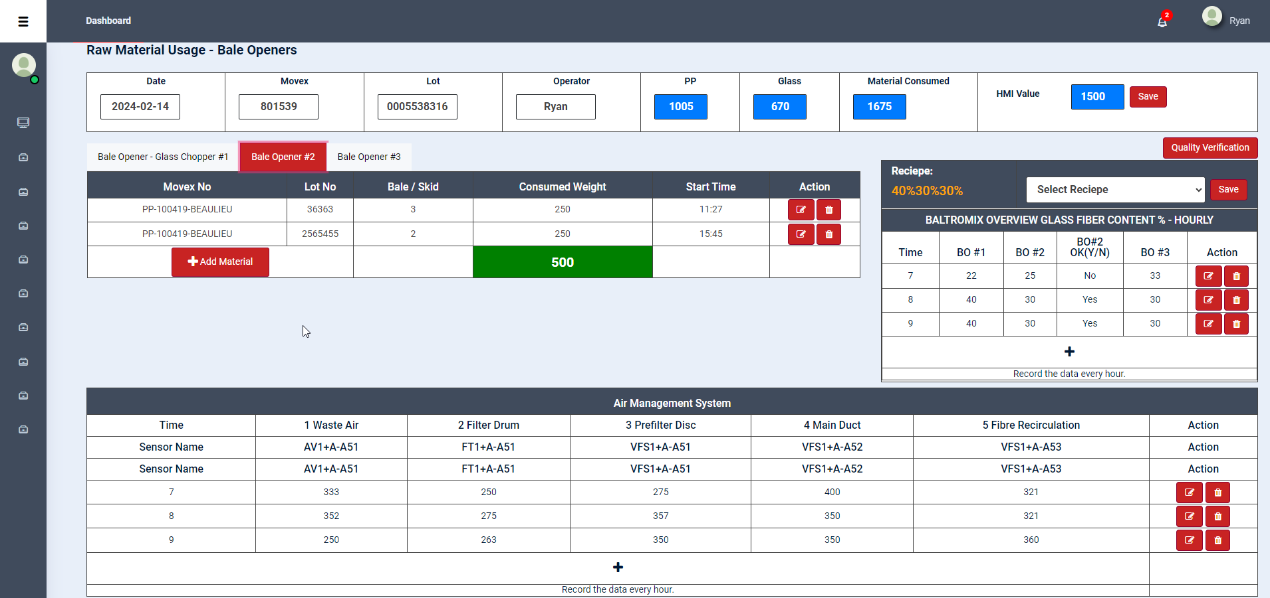
DIGITALIZED DATA MANAGEMENT SYSTEM
Raw Material Usage – Bale Openers Page:
The operator first selects the recipe and saves it to the system. Then the Raw Material details are to be inputted to the system by selecting “Add Material” in each Bale Opener. Based on the PP input given, the Glass qty. is automatically calculated by the system based on the selected recipe.
Air Management System values are also added every hour by the operator.
“Continuous Improvement is better than delayed perfection.” – Mark Twain

Slide 18
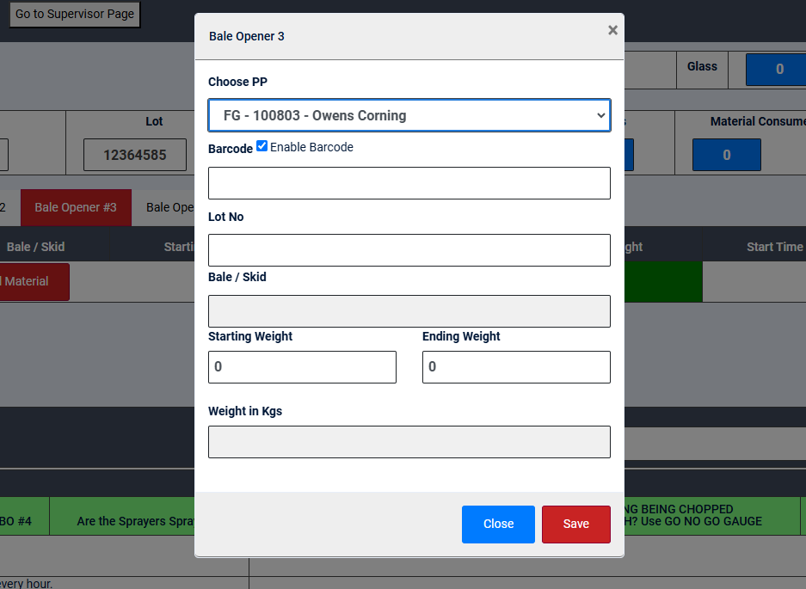
DIGITALIZED DATA MANAGEMENT SYSTEM
Raw Material Entry:
It’s an entry page for raw material that allows the operator to scan the barcode. When the barcode is scanned, it retrieves all values from the label and displays them in the textbox.
“Continuous Improvement is better than delayed perfection.” – Mark Twain

Slide 19
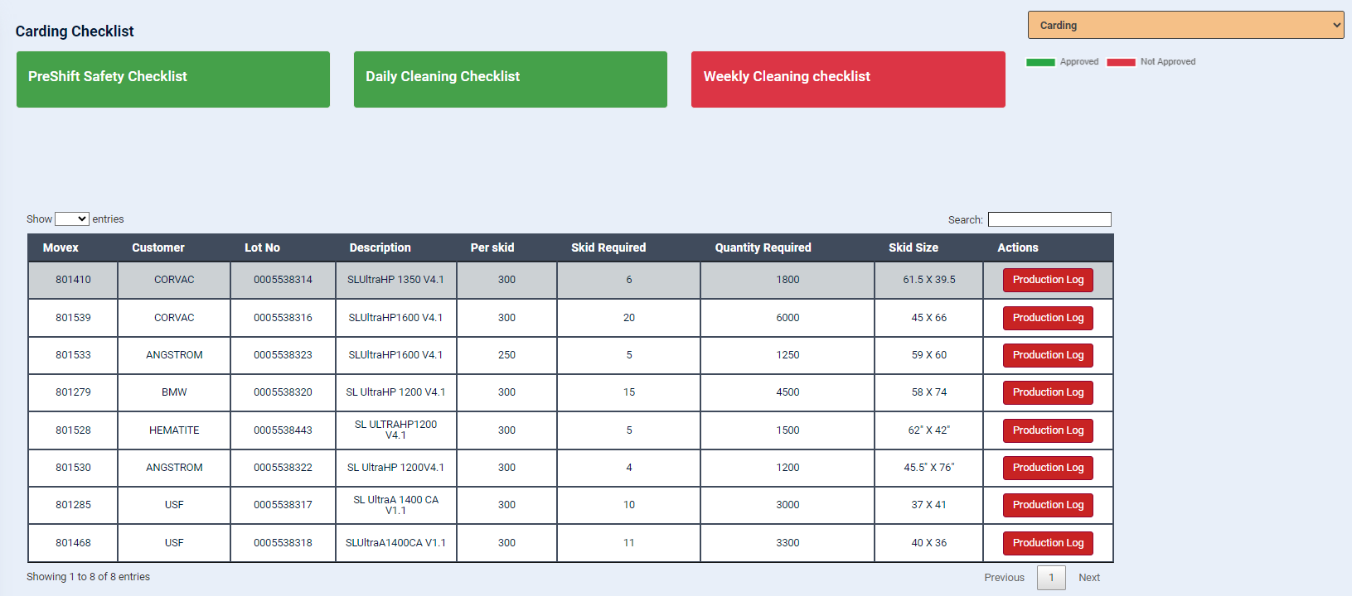
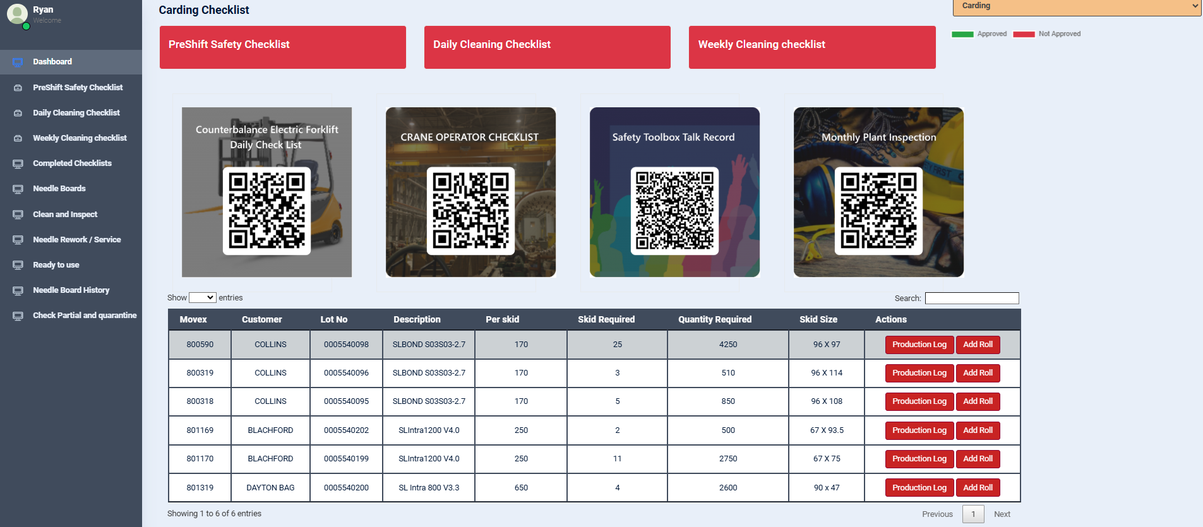
DIGITALIZED DATA MANAGEMENT SYSTEM
Carding Checklists, Record Roll Material & Production Log:
Operator fills the carding checklists from this page.
Shift-wise Production Log details can be entered by selecting the respective MO Production Log. Roll material data can be entered by clicking the respective add roll button.
“Continuous Improvement is better than delayed perfection.” – Mark Twain

Slide 20
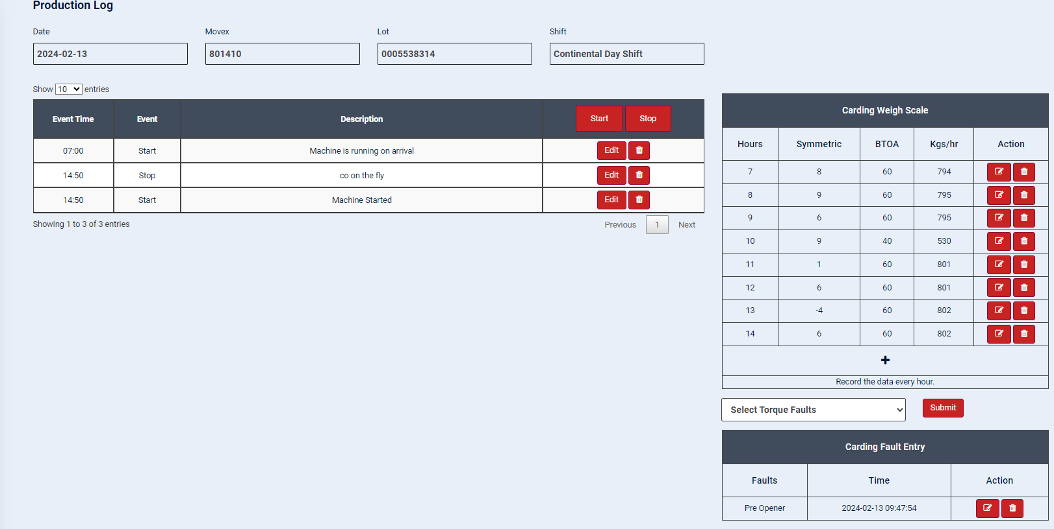
DIGITALIZED DATA MANAGEMENT SYSTEM
Carding Weigh Scale:
Bottom Take Off Apron (BTOA) speed and Kgs/hr are recorded by the Operator every hour.
Torque Faults:
Operators record the type of torque fault with the time stamp as and when it occurs in carding.
Production Log Summary
Machine Start & Stop details with reasons are recorded in this page. This information helps the management to have a clear view of the run-time vs down-time along with carding output.
“Continuous Improvement is better than delayed perfection.” – Mark Twain

Slide 21
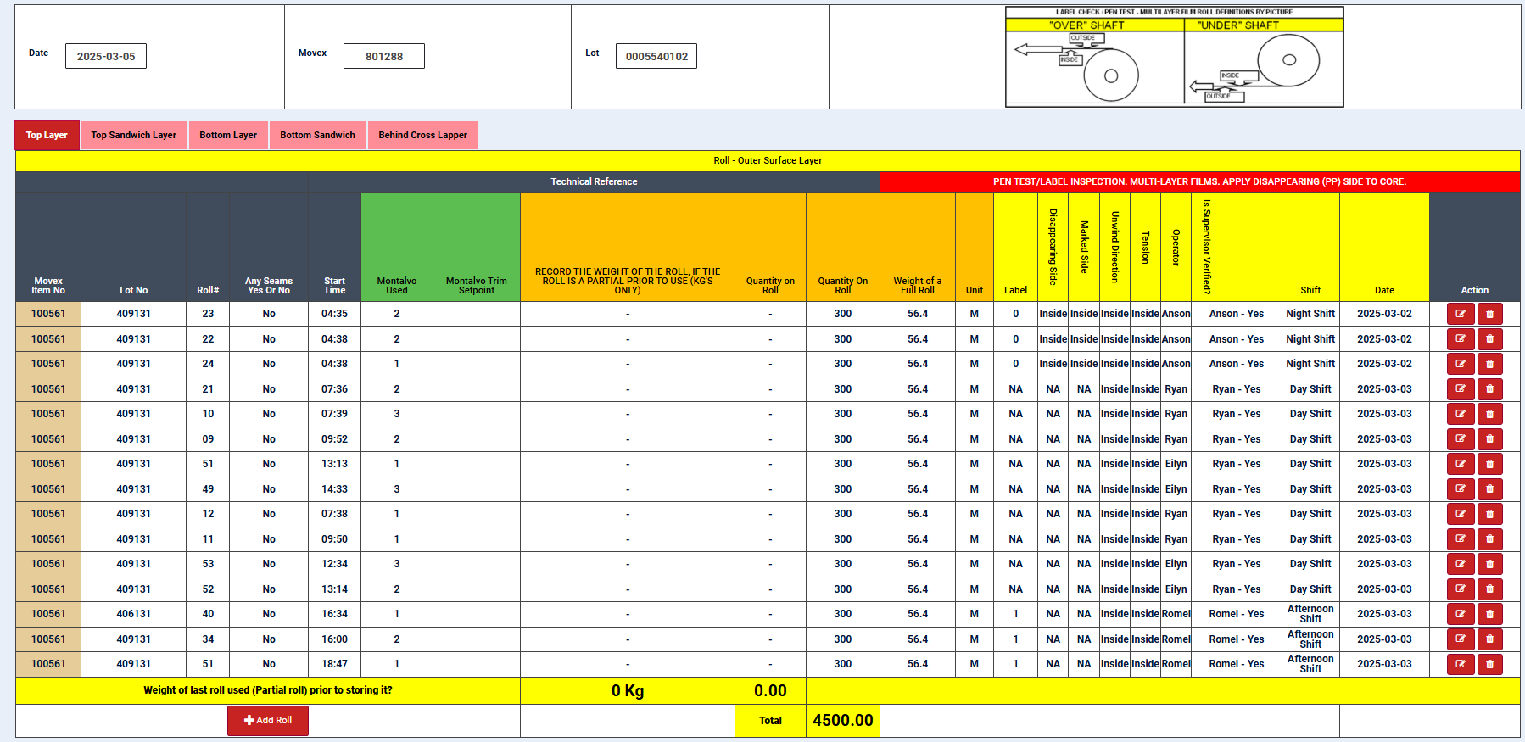
DIGITALIZED DATA MANAGEMENT SYSTEM
Roll Material Data:
It consists of 5 layers and may vary based on the product. The operator can enter the details of the roll on this page, and it displays how much has been consumed at the end of the page.
“Continuous Improvement is better than delayed perfection.” – Mark Twain

Slide 22
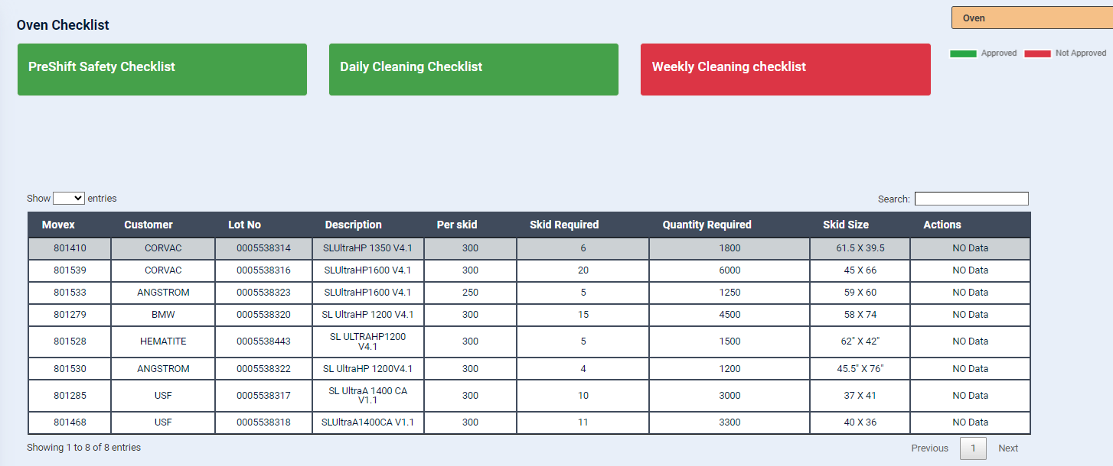
DIGITALIZED DATA MANAGEMENT SYSTEM
Oven Checklists
Operators fill the oven checklists from this page.
“Continuous Improvement is better than delayed perfection.” – Mark Twain

Slide 23
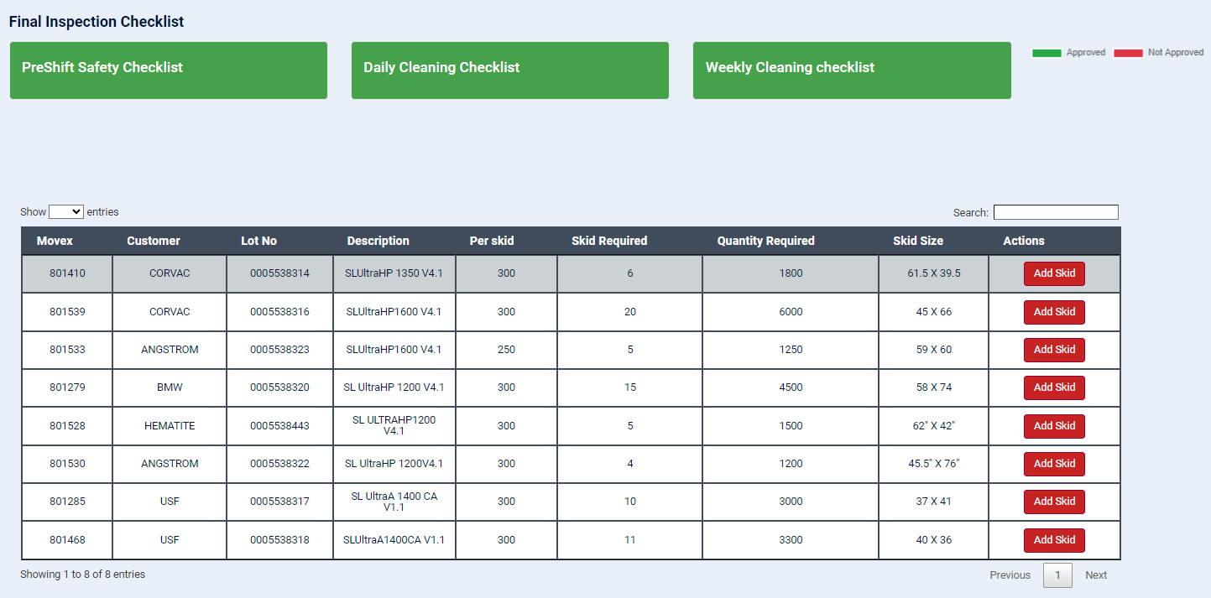
DIGITALIZED DATA MANAGEMENT SYSTEM
Final Inspection / End of Line Checklists
Operators fill the shift-wise Final Inspection checklists from this page for each MO.
“Continuous Improvement is better than delayed perfection.” – Mark Twain

Slide 24
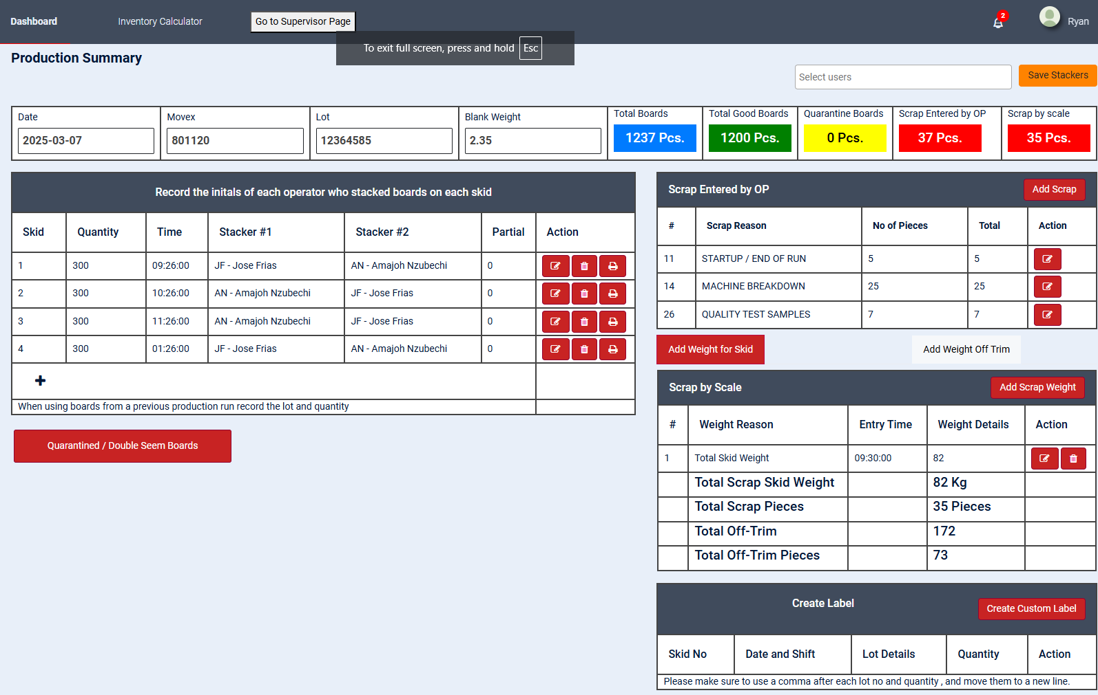
DIGITALIZED DATA MANAGEMENT SYSTEM
End of Line Production Summary
Operators/Stackers enter the skid details as and when they are completed and record if they are partial/quarantine/double seam. Also, the scarp details by nos. as well as weight are entered including the off-trim weights.
“Continuous Improvement is better than delayed perfection.” – Mark Twain

Slide 25
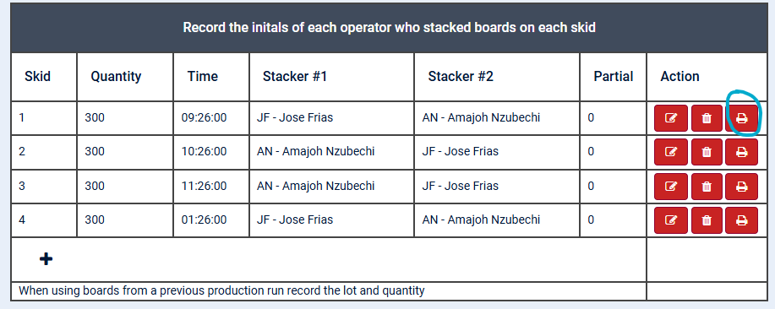
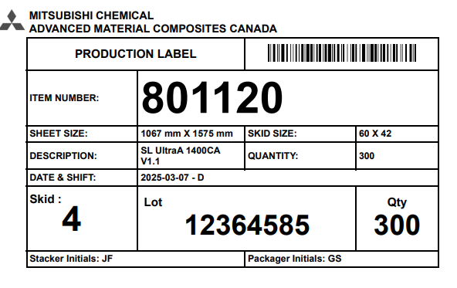
DIGITALIZED DATA MANAGEMENT SYSTEM
Production Label
The label will be generated automatically along with the barcode when the skid enters production. We print it and stick it on the skid for reference. It can add partial information to the label.
“Continuous Improvement is better than delayed perfection.” – Mark Twain

Slide 26
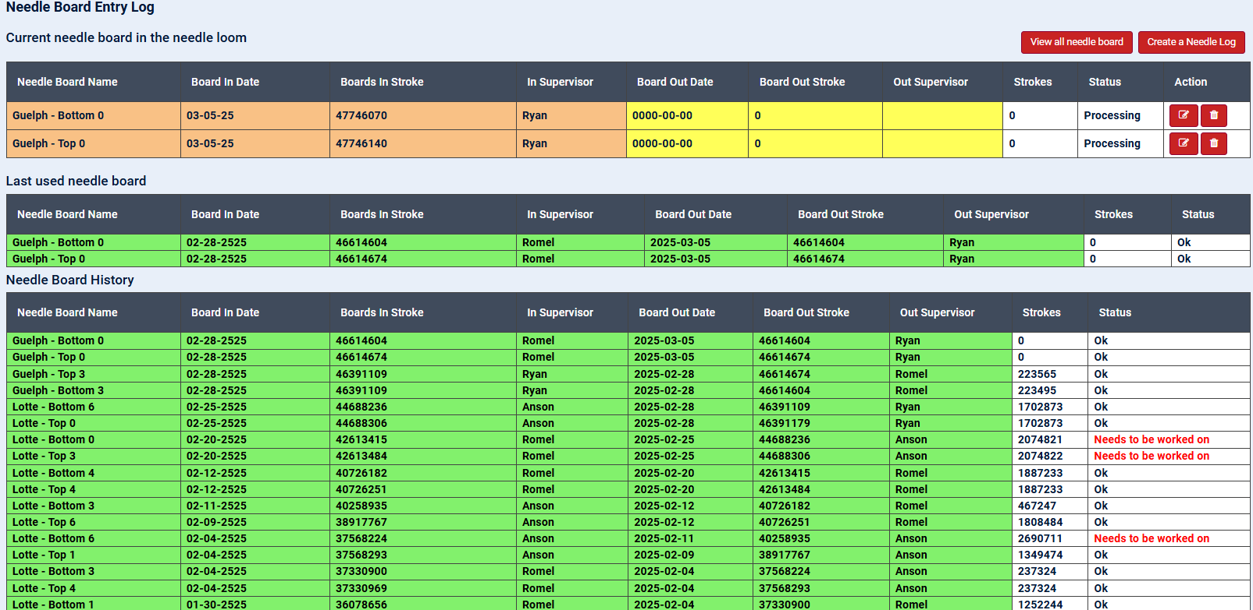
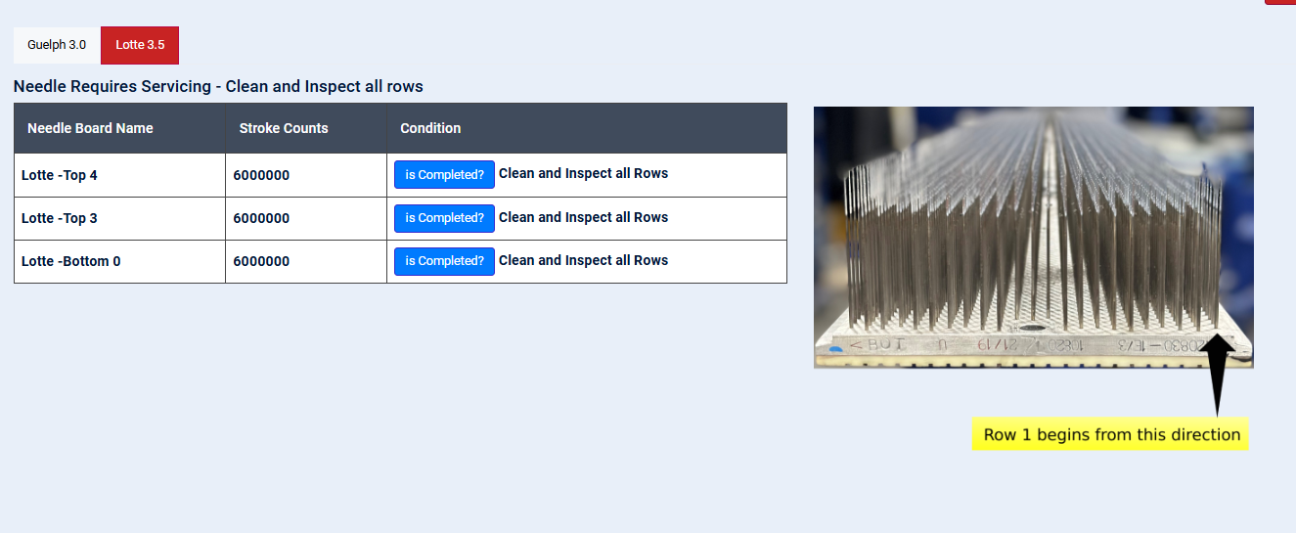
DIGITALIZED DATA MANAGEMENT SYSTEM
Needle Board Entry
We can record the stroke details whenever we change the needle board in and out of the machine.
Needle Board Entry
If the stroke count reaches 2 million, the needle board requires cleaning and inspection. Once it reaches 4 million strokes, it requires needle rework service, which involves removing needles from 1 to 6. This process continues up to 16 million strokes. Once the stroke count reaches 16 million, it will automatically reset and begin from 0
“Continuous Improvement is better than delayed perfection.” – Mark Twain

Slide 27
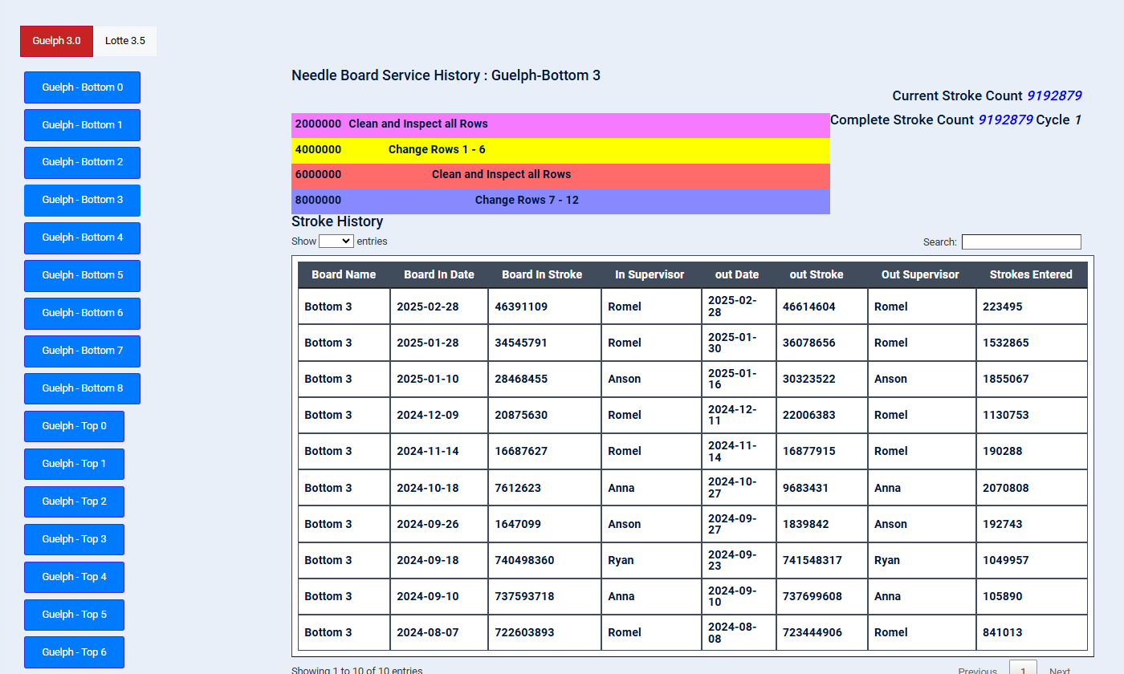
DIGITALIZED DATA MANAGEMENT SYSTEM
History Needle Board
We can view the individual needle board entry history by selecting the needle board name on the left.
We can have a track of individual needle board
“Continuous Improvement is better than delayed perfection.” – Mark Twain

Slide 28


DIGITALIZED DATA MANAGEMENT SYSTEM
Material Handler Access
“Quality is everyone’s responsibility, and we never have to stop getting better.” – W. E. Deming & Jimena Calfa

Slide 29
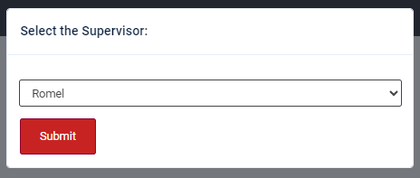
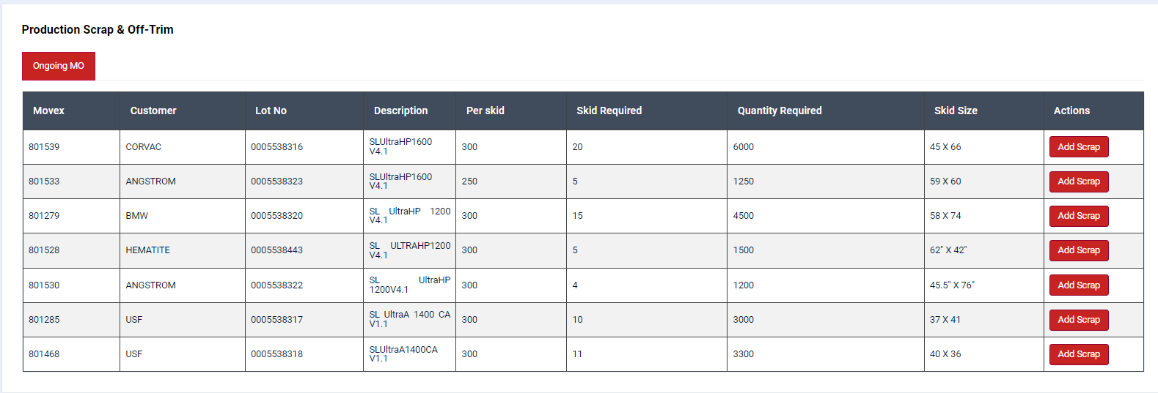
DIGITALIZED DATA MANAGEMENT SYSTEM
Material Handlers, after logging into the system using their credentials, now select the section.
Dashboard Page
This page shows the MOs list of the current week, and the material handler has to select the ongoing MO to add scrap details.
“Quality is everyone’s responsibility, and we never have to stop getting better.” – W. E. Deming & Jimena Calfa

Slide 30
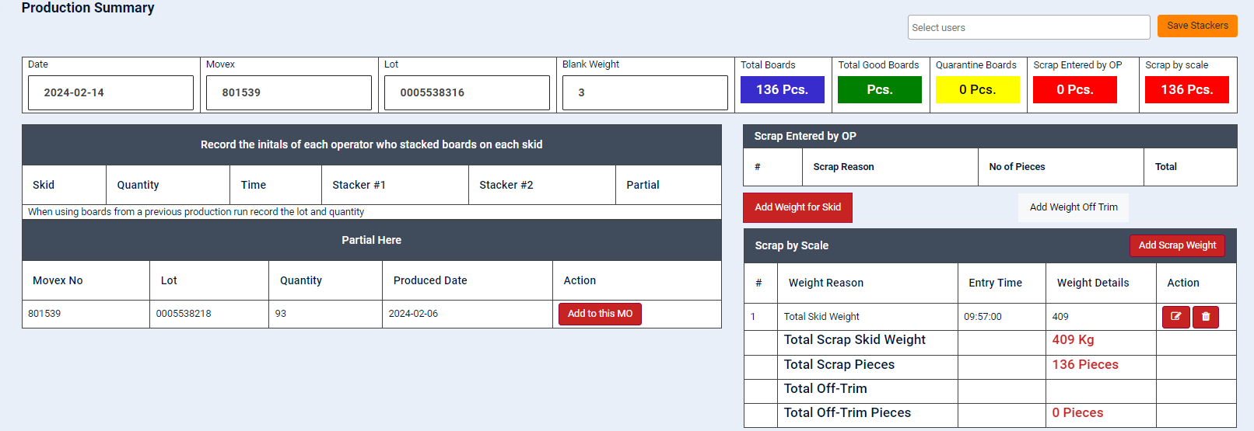
DIGITALIZED DATA MANAGEMENT SYSTEM
Scrap details to be entered
Scarp details by weight is to be added for both scarp skids and off trim in each shift for the particular MO. This will automatically calculate and update the value of “Scrap by Scale” mentioned in the top.
“Quality is everyone’s responsibility, and we never have to stop getting better.” – W. E. Deming & Jimena Calfa

Slide 31
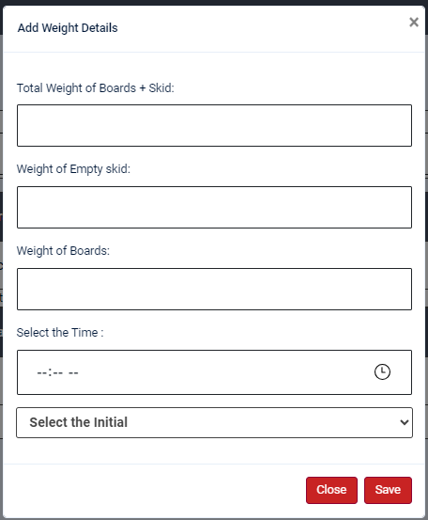
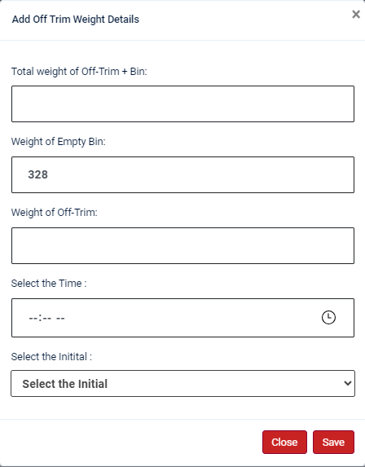
DIGITALIZED DATA MANAGEMENT SYSTEM
Add Weight of Scrap Skid & Off Trim
Material handlers shall measure the weights of the scrap boards skids and off trim bins as and when they are full & record the values timely in these pages.
This will automatically update the total scrap by weight and the respective graphs & analysis for Management’s review.
“Quality is everyone’s responsibility, and we never have to stop getting better.” – W. E. Deming & Jimena Calfa

Slide 32


DIGITALIZED DATA MANAGEMENT SYSTEM
Production Supervisor Access
“Quality is everyone’s responsibility, and we never have to stop getting better.” – W. E. Deming & Jimena Calfa

Slide 33
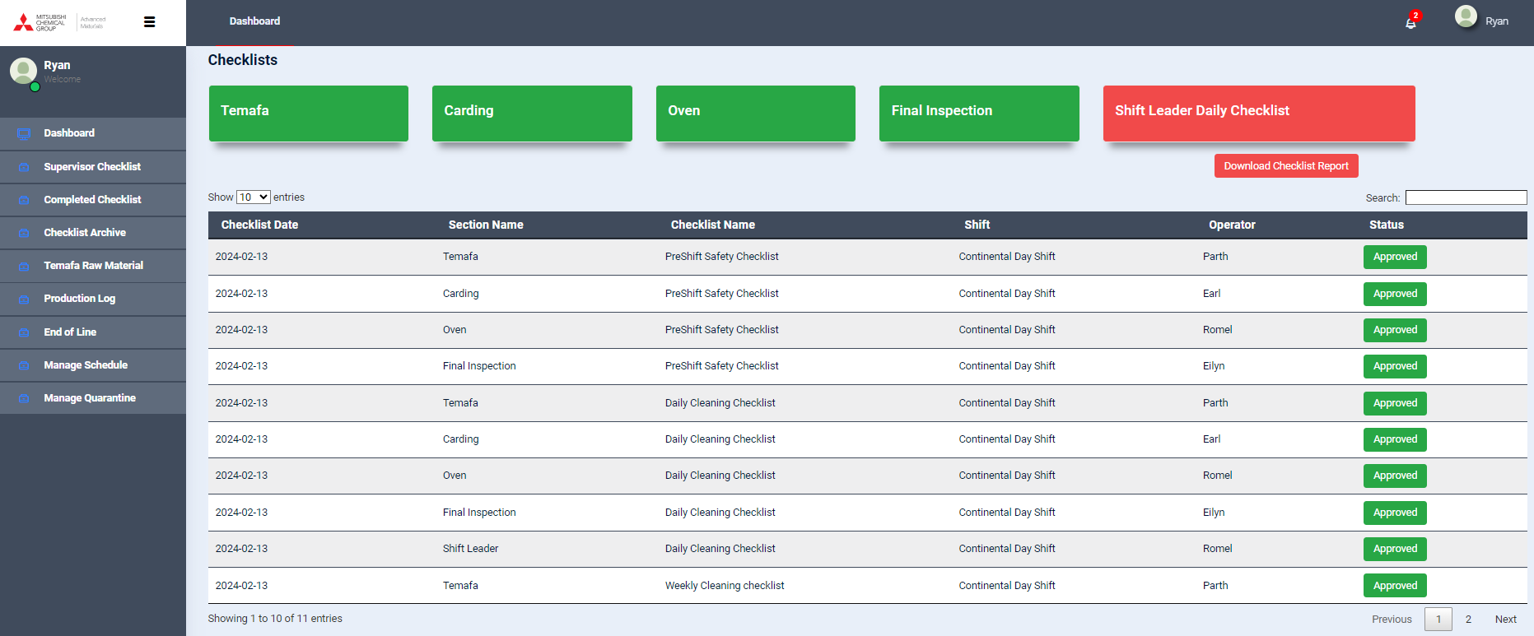
DIGITALIZED DATA MANAGEMENT SYSTEM
Supervisors, after logging into the system using their credentials, see this dashboard
Dashboard Page
It displays all the required checklists based on the workstation. If it is red, it means the checklist is yet to be filled. Once the checklist is done and submitted, it turns green.
“Quality is everyone’s responsibility, and we never have to stop getting better.” – W. E. Deming & Jimena Calfa

Slide 34
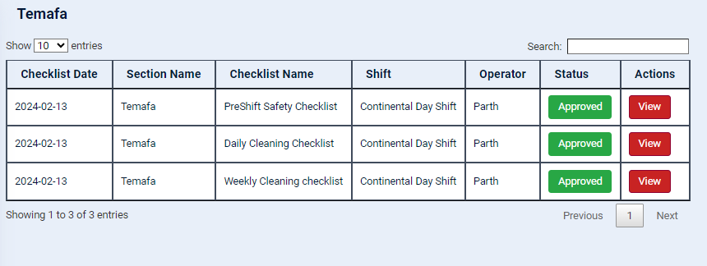
DIGITALIZED DATA MANAGEMENT SYSTEM
Machine-wise Checklist Summary Page
Checklist for each machine can be viewed if it’s approved or not and can be filled as below.
Checklist Page
This is an example of checklist page – Preshift Safety Checklist at Temafa (Bale opening area)
“Improve Quality, you automatically improve Productivity.” – W. Edwards Deming

Slide 35
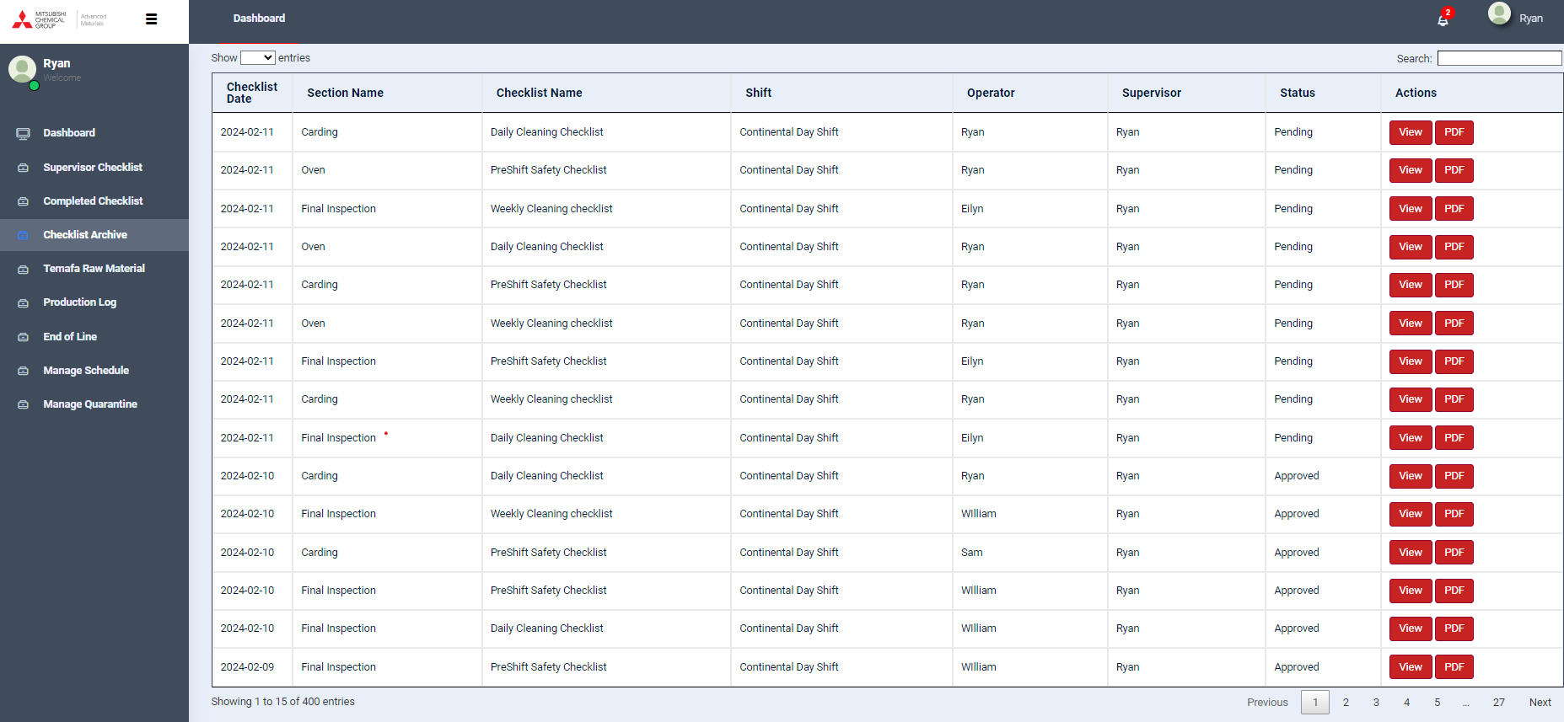
DIGITALIZED DATA MANAGEMENT SYSTEM
Checklist Archive
The whole database of filled-in checklists can be viewed and downloaded in the form of PDF dynamically.
“Continuous Improvement is better than delayed perfection.” – Mark Twain

Slide 36
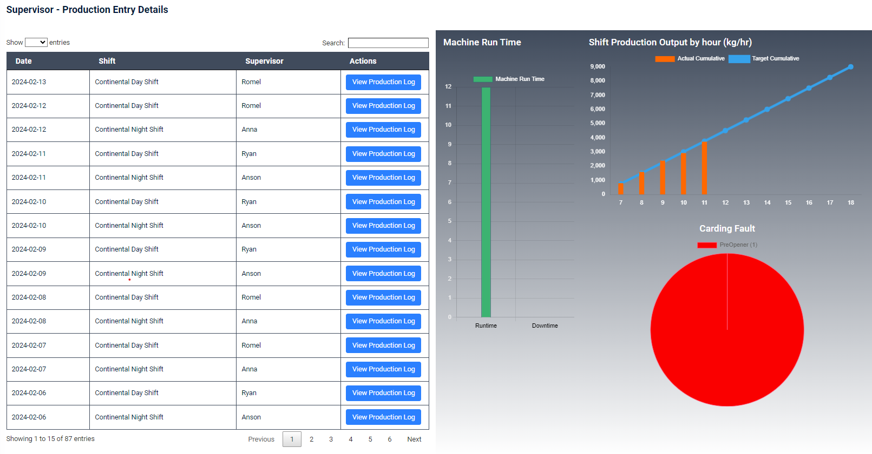
DIGITALIZED DATA MANAGEMENT SYSTEM
Production Dashboard
Graphs indicate the current shift’s:
Machine Run Time & Down Time
Production Output per hour (Kg/hr)
Carding Torque Faults
Production Log Summary
Shift-wise Production Log details can be selected and viewed.
“Continuous Improvement is better than delayed perfection.” – Mark Twain

Slide 37
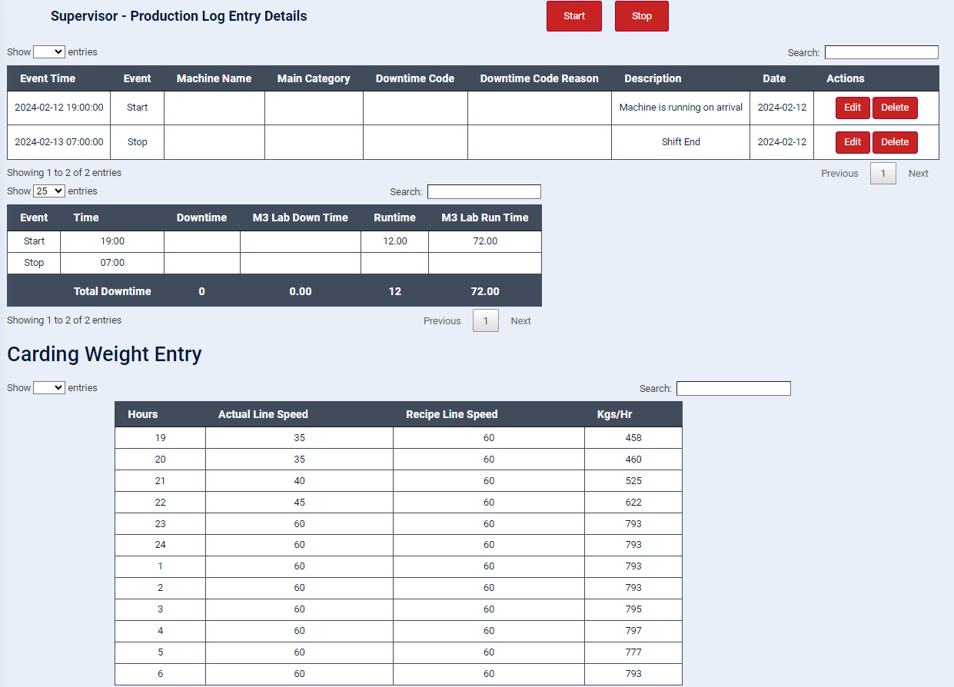
DIGITALIZED DATA MANAGEMENT SYSTEM
Production Log Entry Details
Each shift shall have to record their start & stop logs with reasons which would automatically calculate the machine runtime and downtimes.
This dynamic data shall be used for the graphical representation on dashboard on real-time basis.
Carding Kg/hr details
Operators have access to enter the Kgs/Hr at Carding on hourly basis along with the actual line speed so that productivity can be analysed based on the target.
“Continuous Improvement is better than delayed perfection.” – Mark Twain

Slide 38
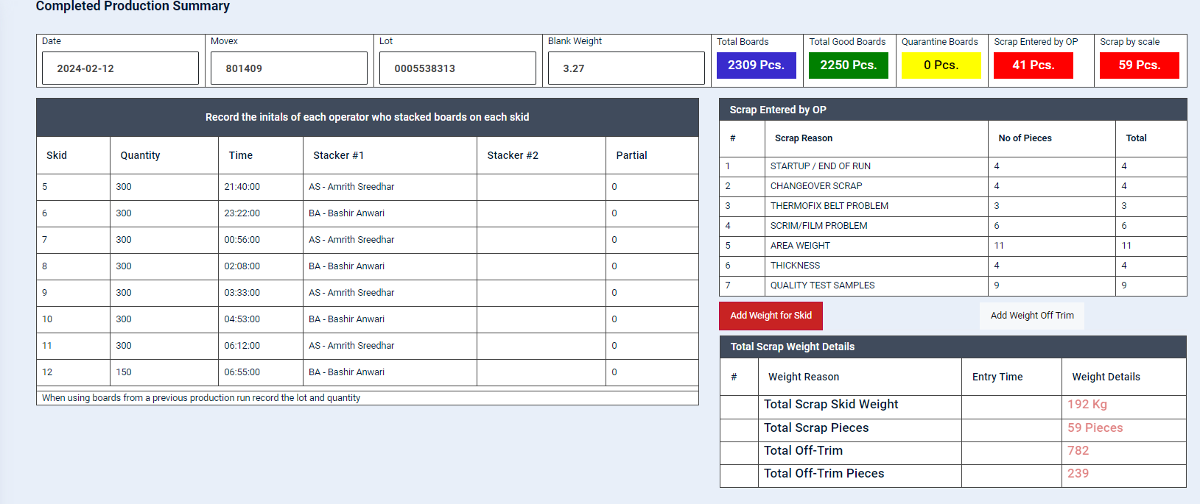
DIGITALIZED DATA MANAGEMENT SYSTEM
End of Line Production Summary
Supervisors can review and make changes (if necessary) in their particular end-of line production summary details.
“Continuous Improvement is better than delayed perfection.” – Mark Twain

Slide 39
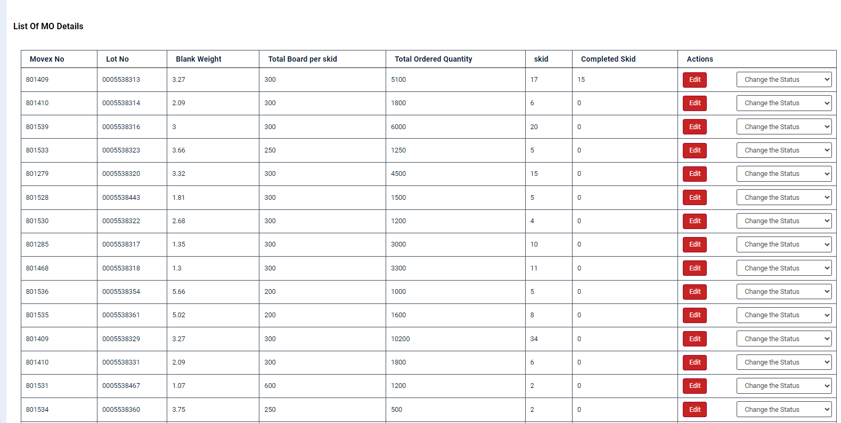
DIGITALIZED DATA MANAGEMENT SYSTEM
List of MO Details
Supervisors can edit the MO status and update them.
“Continuous Improvement is better than delayed perfection.” – Mark Twain

Slide 40
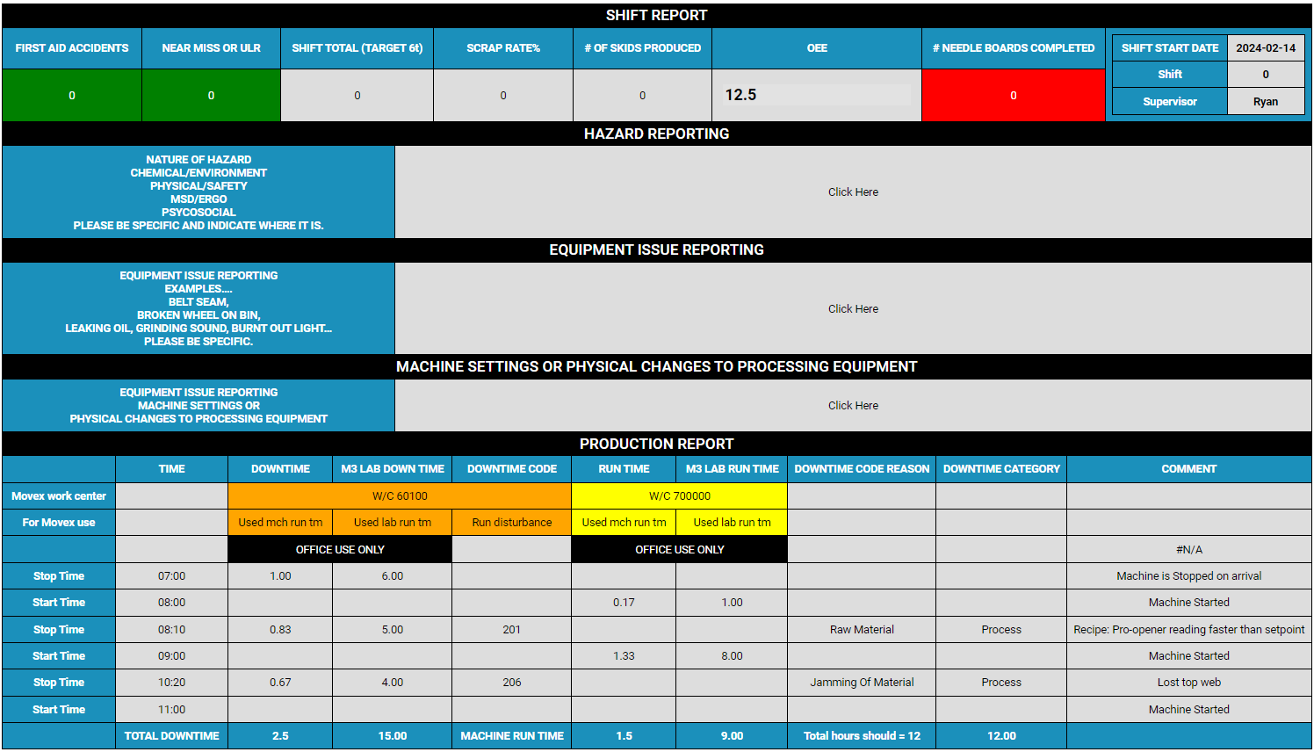
DIGITALIZED DATA MANAGEMENT SYSTEM
Shift Report:
Supervisors can prepare the Shift Report in the new system by just filling the fields highlighted here. All other details shall be automatically filled from various other pages of Operator’s login.
“Continuous Improvement is better than delayed perfection.” – Mark Twain

Slide 41
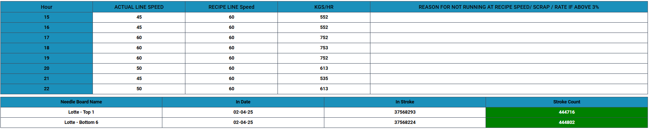


DIGITALIZED DATA MANAGEMENT SYSTEM
Shift Report (Cont.):
Supervisors can also send an email to all the required addressees with the detailed shift report in the given format by clicking the “Send Email” button.
“Continuous Improvement is better than delayed perfection.” – Mark Twain

Slide 42


DIGITALIZED DATA MANAGEMENT SYSTEM
Safety & Production Department
“Quality is everyone’s responsibility, and we never have to stop getting better.” – W. E. Deming & Jimena Calfa

Slide 43

DIGITALIZED DATA MANAGEMENT SYSTEM
Production Manager has the administrative control on the portal
Production Manager, after logging into the system, see this dashboard for produced weekly by day wise.
Production Manger Dashboard
The Production Manager has access to view the total production, broken down by day wise and shift wise.
It has the facility to view the runtime and downtime of the supervisor
“Quality is everyone’s responsibility, and we never have to stop getting better.” – W. E. Deming & Jimena Calfa

Slide 44

DIGITALIZED DATA MANAGEMENT SYSTEM
Employee Management
Production Manager has the access to create, edit and delete the access for all other users.
The role of access is selected as needed.
“Quality is everyone’s responsibility, and we never have to stop getting better.” – W. E. Deming & Jimena Calfa

Slide 45

DIGITALIZED DATA MANAGEMENT SYSTEM
Production Dashboard
The whole database of Production Log (date & shift-wise) can be viewed and downloaded in the form of PDF dynamically.
“Continuous Improvement is better than delayed perfection.” – Mark Twain

Slide 46

DIGITALIZED DATA MANAGEMENT SYSTEM
Production Dashboard
Production Manager can view the detailed Production Log of any day – any shift by selecting the same.
The details pertaining to machine run-time, downtime, reasons for stopping the machine, carding weights etc. can be viewed.
“Continuous Improvement is better than delayed perfection.” – Mark Twain

Slide 47

DIGITALIZED DATA MANAGEMENT SYSTEM
Quarantine Details
Production Manager has access to view the Quarantine boards details like Quarantine date, Movex No., Lot No., Qunatity etc. However, in future, the access to edit the quarantine boards will be provided to Quality Manager.
“Continuous Improvement is better than delayed perfection.” – Mark Twain

Slide 48

DIGITALIZED DATA MANAGEMENT SYSTEM
Checklist Questions Master Page
The Production Manager only has the access to add, edit or delete the master log. This page is used for updation of checklist questions of various machines in all access levels.
“Improve Quality, you automatically improve Productivity.” – W. Edwards Deming

Slide 49

DIGITALIZED DATA MANAGEMENT SYSTEM
Product Details Master List
This page is used to add, edit or delete the product details from the master list to replicate further in all access levels.
“Continuous Improvement is better than delayed perfection.” – Mark Twain

Slide 50


DIGITALIZED DATA MANAGEMENT SYSTEM
Raw Material Details Master List
This page is used to add, edit or delete the Raw material details from the master list to replicate further in all access levels.
Engineering Calculator
It has a textbox to search for raw materials by raw material number. Once entered, it populates the raw material number and displays the details in the textbox on the right side.
Then, enter the weight, and it will calculate the total meters of material(based on the unit it will be calculated).
“Continuous Improvement is better than delayed perfection.” – Mark Twain

Slide 51

DIGITALIZED DATA MANAGEMENT SYSTEM
Downtime Categories Master List
This page is used to add, edit or delete the downtime categories from the master list to replicate further in all access levels.
“Continuous Improvement is better than delayed perfection.” – Mark Twain

Slide 52


DIGITALIZED DATA MANAGEMENT SYSTEM
Quality Department
“Quality is everyone’s responsibility, and we never have to stop getting better.” – W. E. Deming & Jimena Calfa

Slide 53


DIGITALIZED DATA MANAGEMENT SYSTEM
MO view
Quality can view ongoing MOs for the current week.
Quarantine
Quality has access to move boards from quarantine to either the good board or scrap board, using the appropriate reason.
“Continuous Improvement is better than delayed perfection.” – Mark Twain

Slide 54

DIGITALIZED DATA MANAGEMENT SYSTEM
Product Attributes
Each product must have its own properties set to display on the final inspection page.
“Continuous Improvement is better than delayed perfection.” – Mark Twain

Slide 55

DIGITALIZED DATA MANAGEMENT SYSTEM
Product Specification Entry
Quality manager can have access to create, modify and delete the specification of the product.
“Continuous Improvement is better than delayed perfection.” – Mark Twain

Slide 56

DIGITALIZED DATA MANAGEMENT SYSTEM
Product Specification View
The Quality Manager can view the specification details entered on another page
“Continuous Improvement is better than delayed perfection.” – Mark Twain

Slide 57

DIGITALIZED DATA MANAGEMENT SYSTEM
Column Visibility
The Quality Manager can select the product and determine which columns should be visible to the operator, based on the product.
After selecting the product from the dropdown, choose the display type: front page and production, or front page only
“Continuous Improvement is better than delayed perfection.” – Mark Twain

Slide 58



DIGITALIZED DATA MANAGEMENT SYSTEM
Final Inspection View
The Quality Manager can view the final inspection page after it has been entered by the quality inspector at the end of the line.
Fault Images
The defect images can be displayed for quality checking.
“Continuous Improvement is better than delayed perfection.” – Mark Twain

Slide 59



DIGITALIZED DATA MANAGEMENT SYSTEM
Final Inspection Production Data
Each skid quality inspector will enter the production data to ensure quality.
Fiber
Every two skids will record the fiber data to check the glass content.
Data
It calculates and displays the average thickness, weight, and density of all skids automatically
“Continuous Improvement is better than delayed perfection.” – Mark Twain

Slide 60

DIGITALIZED DATA MANAGEMENT SYSTEM
C of A
The certificate will be generated automatically, with some textboxes left empty. These empty textboxes will be filled by the quality technician after completing the testing in the lab
“Continuous Improvement is better than delayed perfection.” – Mark Twain

Slide 61


DIGITALIZED DATA MANAGEMENT SYSTEM
Maintenance Department
“Quality is everyone’s responsibility, and we never have to stop getting better.” – W. E. Deming & Jimena Calfa

Slide 62

DIGITALIZED DATA MANAGEMENT SYSTEM
Dashboard
Maintenance manager dashboard displaying downtime weekly charts by day wise
“Continuous Improvement is better than delayed perfection.” – Mark Twain

Slide 63

DIGITALIZED DATA MANAGEMENT SYSTEM
Dashboard
Technician page to record start and stop repair time
Those data will be rendered in maintenance manager page
“Continuous Improvement is better than delayed perfection.” – Mark Twain

Slide 64

DIGITALIZED DATA MANAGEMENT SYSTEM
Maintenance Data
All maintenance data can be viewed on this page.
The data can be filtered by entering any key in the search textbox.
“Continuous Improvement is better than delayed perfection.” – Mark Twain

Slide 65


DIGITALIZED DATA MANAGEMENT SYSTEM
Monthly Tracking Data - Fault
The first table represents how many faults occurred each day. These faults are accumulated by category, and the total number of faults is displayed in the last column.
Monthly Tracking Downtime Hours
The second table represents how many downtime hours occurred each day. The last column displays the total downtime accumulated each day
.
The third table displays the top 5 problems that occurred the most.
“Continuous Improvement is better than delayed perfection.” – Mark Twain

Slide 66
DIGITALIZED DATA MANAGEMENT SYSTEM
Plant Manager Department
“Quality is everyone’s responsibility, and we never have to stop getting better.” – W. E. Deming & Jimena Calfa

Slide 67

DIGITALIZED DATA MANAGEMENT SYSTEM
“Continuous Improvement is better than delayed perfection.” – Mark Twain

Slide 68

DIGITALIZED DATA MANAGEMENT SYSTEM
“Continuous Improvement is better than delayed perfection.” – Mark Twain

Slide 69




DIGITALIZED DATA MANAGEMENT SYSTEM
Top Management Access
“Management is, above all, a practice where art, science and craft meet. ” – Henry Mintzberg

Slide 70


DIGITALIZED DATA MANAGEMENT SYSTEM
Master page
This is the master page where all modules are linked, allowing easy access to any module. It also displays the current day's production, runtime, and downtime.
“Safety First! An Ounce of Prevention is worth a Pound of Cure.” – Benjamin Franklin

Slide 71

DIGITALIZED DATA MANAGEMENT SYSTEM
Top management, after logging into the system using their credentials, see this dashboard
Real-time Feeder & Fine Opener Humidity is displayed using API.
Dashboard (Page-1)
The following statistical analysis of data shall be presented to the top management at this page:
Machine Run Time
Carding output by hour
Final Output by hour
Weekly Carding Output
Weekly Production Output
Previous week Production & Scrap graph
Carding Torque Faults
“Safety First! An Ounce of Prevention is worth a Pound of Cure.” – Benjamin Franklin

Slide 72

DIGITALIZED DATA MANAGEMENT SYSTEM
Dashboard (Page-2)
The following statistical analysis of data shall be presented to the top management at this page:
Details of Scrap produced (weekly) along with reason categorization
Details of Machine Downtime (weekly) along with reason categorization
“Improve Quality, you automatically improve Productivity.” – W. Edwards Deming

Slide 73

DIGITALIZED DATA MANAGEMENT SYSTEM
Detailed Production Shift-Wise
The whole database of production logs (shift-wise) can be viewed by selecting the required date & shift dynamically.
“Continuous Improvement is better than delayed perfection.” – Mark Twain

Slide 74
DIGITALIZED DATA MANAGEMENT SYSTEM
Ongoing MO View
It displays all the ongoing MOs for the current week. It also highlights the product being produced currently in green.
“Quality is everyone’s responsibility, and we never have to stop getting better.” – W. E. Deming & Jimena Calfa

Slide 75
DIGITALIZED DATA MANAGEMENT SYSTEM
Upcoming MO Planning
Next week’s lookahead plan for MOs can also be updated & depicted in this page along with the planned shipping date.
Completed MOs List
It displays all the completed MOs along with the completed date & time.
“Focus on being productive instead of busy.” – Tim Ferriss

Slide 76
ACCESS LEVELS
Top Management
Plant Manager
Safety & Production
Engineering
Material
Production Supervisor
Quality
Maintenance
Production Operator
Material Handler
Sales
Launched & Live
Under Development
Future Expansion
“Do it Right the First Time and Every Time” – Henry Ford

Slide 77




DIGITALIZED DATA MANAGEMENT SYSTEM
SCOPE FOR FUTURE EXPANSION & OPTIMIZATION
The following enhancements are planned to be undertaken as a part of future expansion roadmap of the Project:
Safety Participation Statistical Data
Deviation Alert
Downtime Incremental Alert
Engineering Access with detailed analysis & various calculators
New Product Estimate Calculator
Product Technical Data Analysis
Photographic evidence capturing feature (using ipads)
And many more…
“Continuous Improvement is better than delayed perfection.” – Mark Twain

Slide 78

“The Art of Improving is the Art of Assisting Discovery”
- Mark Van Doren

Slide 79

Happy to answer any Questions!

